Slide 1

Spacecraft Manager
Alexander Hauer

Slide 2
What it does
This program manages a spacecraft, which contains different methods relating to Crew, Bridge and Cargo management
Together with MySql integration to keep and maintain the information

Slide 3
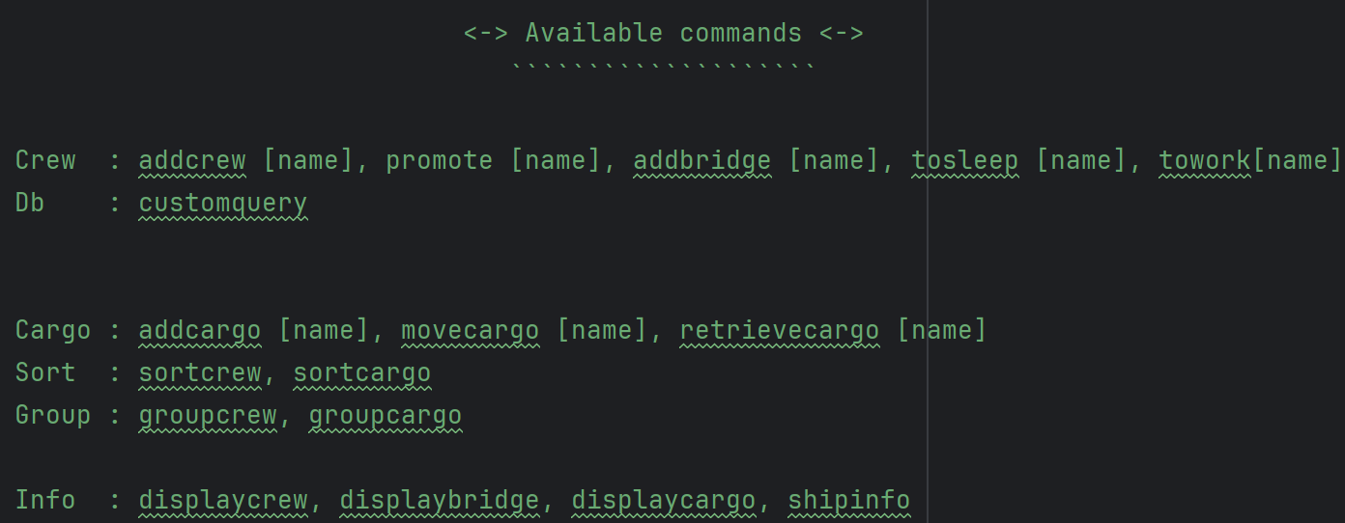
Code snippet
Different commands are available for different users

Slide 4
Dev. process
Picking off last time, threads were implemented to speed up the grouping methods
Afterwards, MySql was connected
Methods to insert and update the entries
Create different login options
Unit tests were added to ensure proper functionality

Slide 5
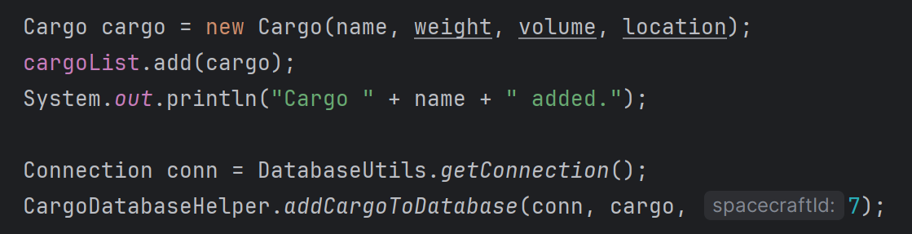
Code snippet II
The code was continued such that each time an object was added/updated, it was also added/updated to the database

Slide 6
Problems
MySql initial connection – I encountered a lot of error connecting to the database in the beginning, as well as not understanding completely each error message

Slide 7
What went smooth
Thread implementation – although it was a new concept to learn, it was quick to troubleshoot
Unit tests – quick to add, no errors there

Slide 8





Thank you for your attention

